Slide 1

Codergirl – Frontend
Unit 2 - Class 7
December 19, 2020
Notes:
1

Slide 2
Agenda
Section 11 - Routing
Holiday break is 12/28 to 12/30, with the last class being 12/23 and the first of new year being on 1/4/21
Notes:
2

Slide 3
Routing
Separate pages for servers, users, home
Having separate pages and routing to separate pages.
/users goes to users component
/servers goes to servers component
/ goes to home component
App.modules.ts about routes (appRoutes)
Notes:
3

Slide 4
Routing – app.module.ts
Notes:
4

Slide 5
Routing – app.component.html
Notes:
5

Slide 6
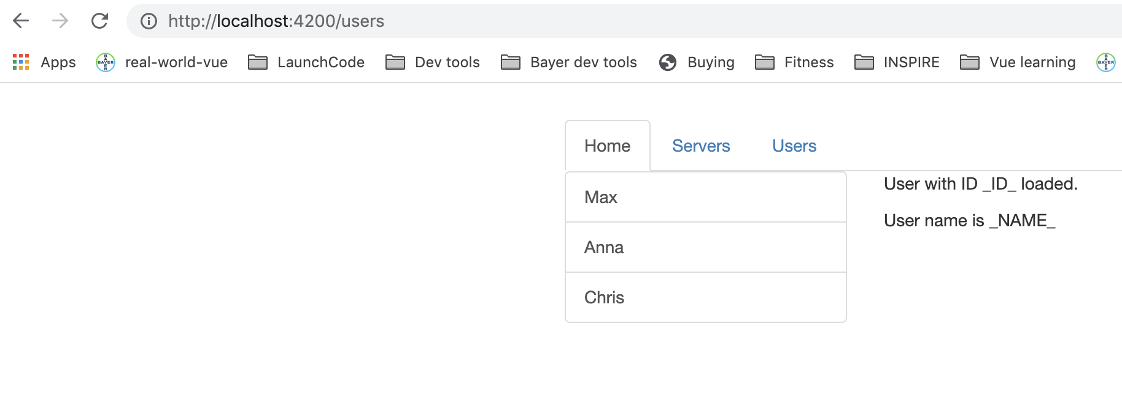
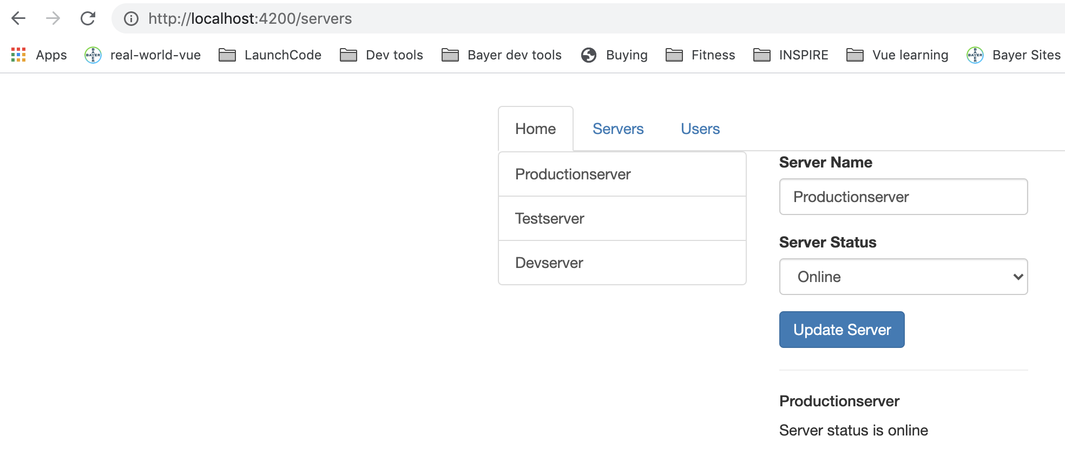
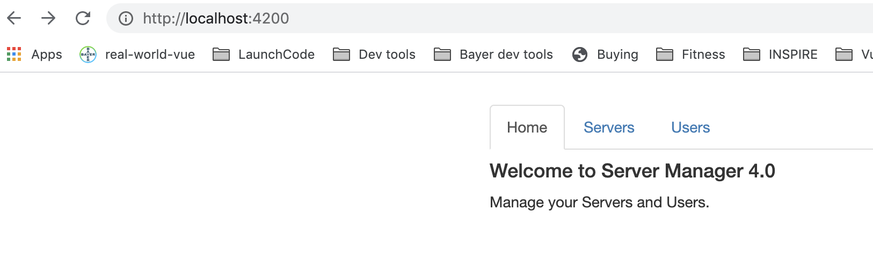
Test site
/users goes to users component
/servers goes to servers component
/ goes to home component
Works but app reloads
Notes:
6

Slide 7
Fix links
Works but app reloads
Notes:
7

Slide 8
Navigation – user directive instead
app-component.html. Works without reload.
Works without the /servers with servers as well.
Notes:
8

Slide 9
Navigation paths
/servers Absolute path
Relative path servers or ./servers or ../servers
Notes:
9

Slide 10
Active Router Links
/servers Absolute path
Relative path servers or ./servers or ../servers
Notes:
10

Slide 11
Navigating Programmatically
Notes:
11

Slide 12
Relative paths for Navigating Programmatically
Notes:
12

Slide 13
Relative paths for Navigating Programmatically
Notes:
13

Slide 14
Relative paths for Navigating Programmatically
Notes:
14

Slide 15
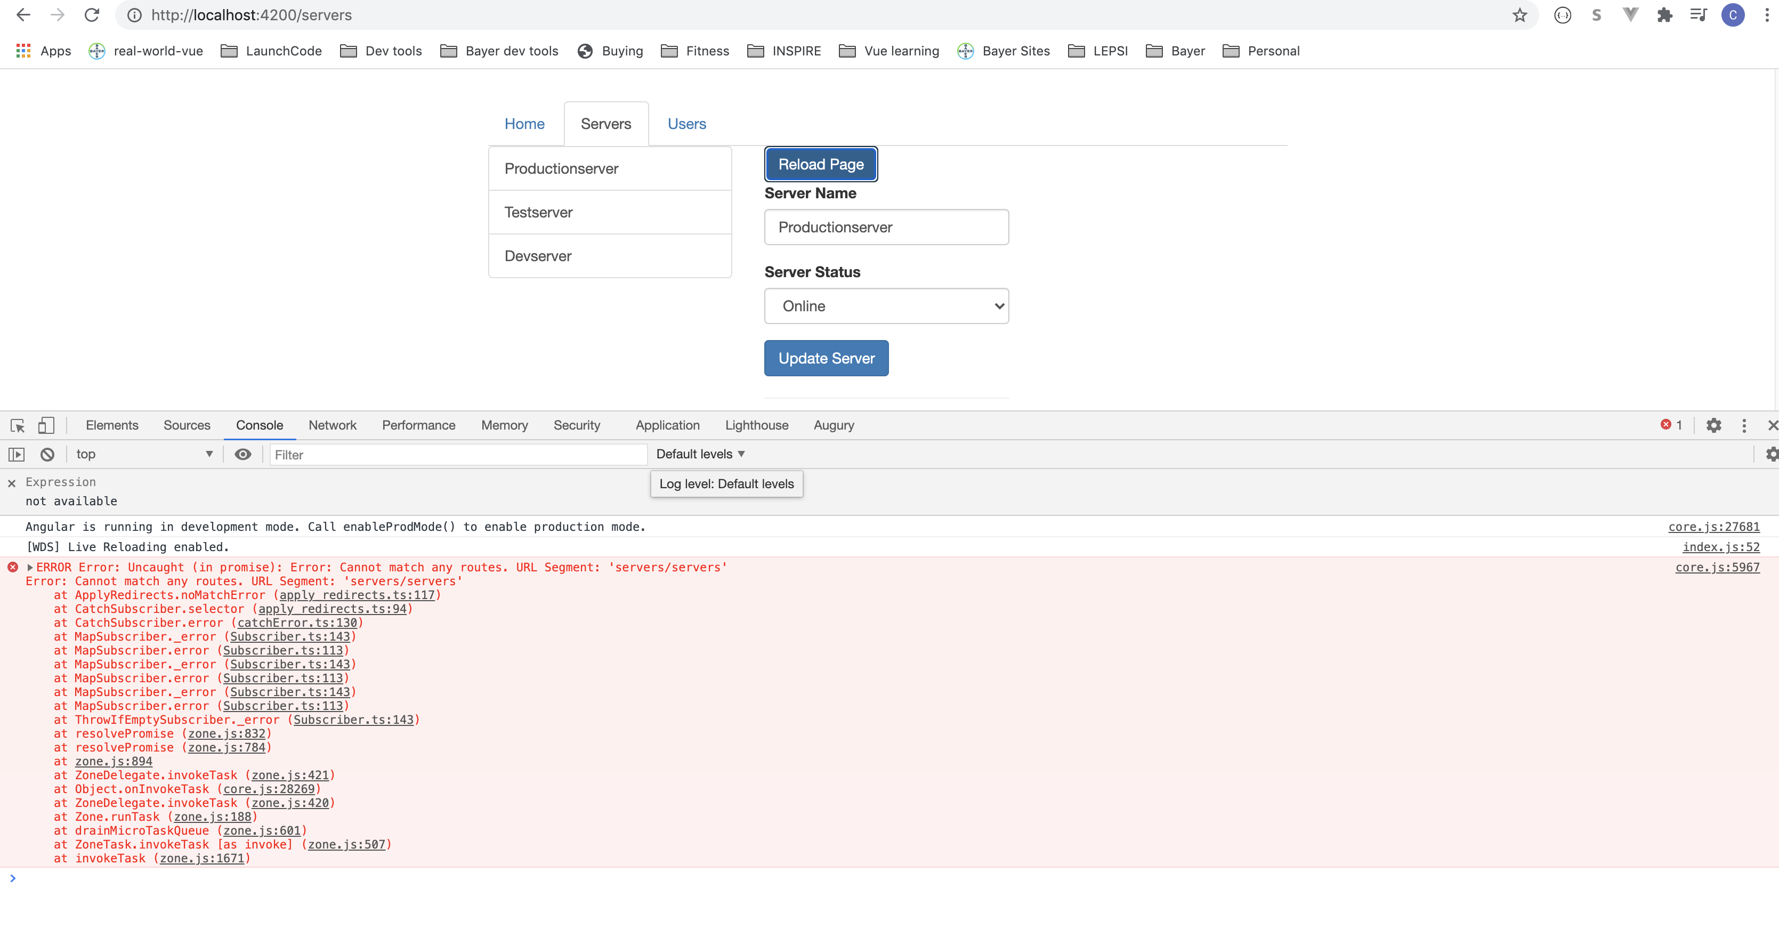
Relative paths for Navigating Programmatically
Notes:
15

Slide 16
Passing Parameters to Routes
Notes:
16

Slide 17
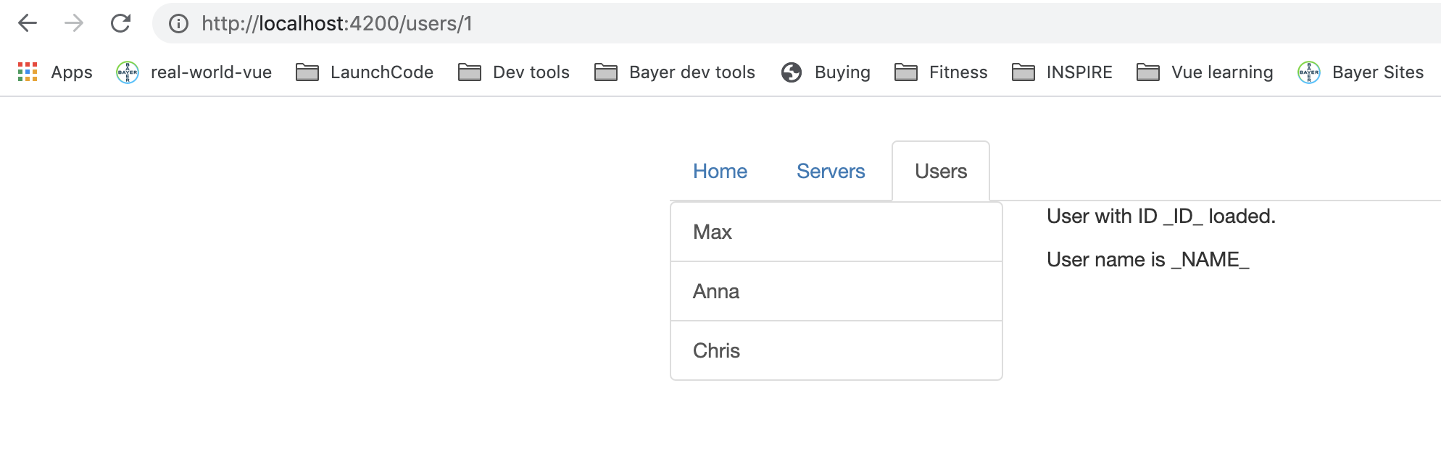
Passing Parameters to Routes
Notes:
17

Slide 18
Fetching Route Parameters
Notes:
https://basarat.gitbook.io/typescript/future-javascript/classes#access-modifiers
https://medium.com/young-coder/private-fields-in-typescript-3-8-true-privacy-at-last-fb4f194305d9
18

Slide 19
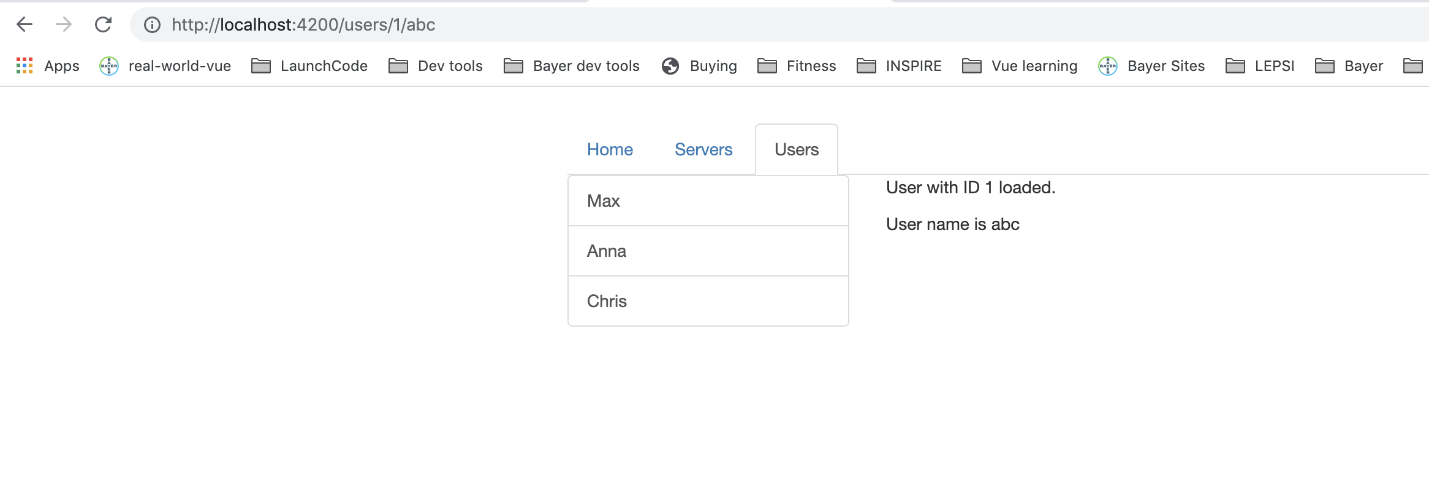
Testing route parameters
Notes:
https://basarat.gitbook.io/typescript/future-javascript/classes#access-modifiers
https://medium.com/young-coder/private-fields-in-typescript-3-8-true-privacy-at-last-fb4f194305d9
19

Slide 20
Fetching Route parameters reactively
this.route.params is an Observable
params might change in the future, if a user clicks, but u don’t know when. Can’t block code.
Observables are a feature added by a third party package, heavily used by Angular
Allow you to work with asynchronous tasks.
Observable is a way to subscribe to an event that might occur in the future to then execute that code when it happens.
Notes:
https://basarat.gitbook.io/typescript/future-javascript/classes#access-modifiers
https://medium.com/young-coder/private-fields-in-typescript-3-8-true-privacy-at-last-fb4f194305d9
20

Slide 21
Fetching Route parameters reactively
Notes:
https://basarat.gitbook.io/typescript/future-javascript/classes#access-modifiers
https://medium.com/young-coder/private-fields-in-typescript-3-8-true-privacy-at-last-fb4f194305d9
21

Slide 22
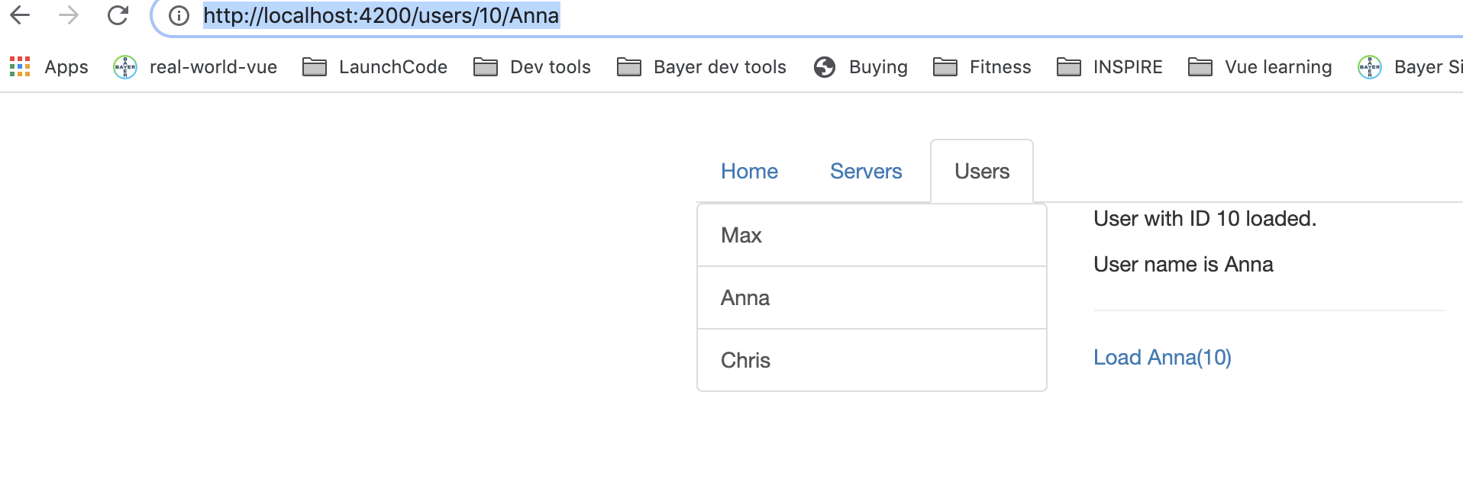
Fetching Route parameters reactively
Notes:
https://basarat.gitbook.io/typescript/future-javascript/classes#access-modifiers
https://medium.com/young-coder/private-fields-in-typescript-3-8-true-privacy-at-last-fb4f194305d9
22

Slide 23
Route Observables
In order to destroy the route subscription, delete it in onDestroy method.
Notes:
https://basarat.gitbook.io/typescript/future-javascript/classes#access-modifiers
https://medium.com/young-coder/private-fields-in-typescript-3-8-true-privacy-at-last-fb4f194305d9
23

Slide 24
Passing Query parameters and fragments
Passing and retrieving localhost:4200/users/10/Anna?mode=editing#loading
Notes:
https://basarat.gitbook.io/typescript/future-javascript/classes#access-modifiers
https://medium.com/young-coder/private-fields-in-typescript-3-8-true-privacy-at-last-fb4f194305d9
24

Slide 25
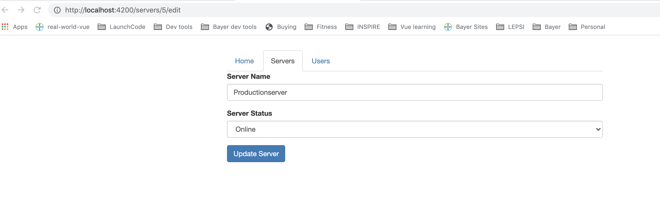
Passing Query parameters and fragments
Notes:
https://basarat.gitbook.io/typescript/future-javascript/classes#access-modifiers
https://medium.com/young-coder/private-fields-in-typescript-3-8-true-privacy-at-last-fb4f194305d9
25

Slide 26
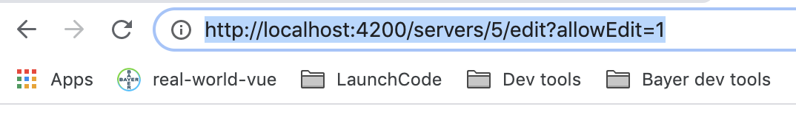
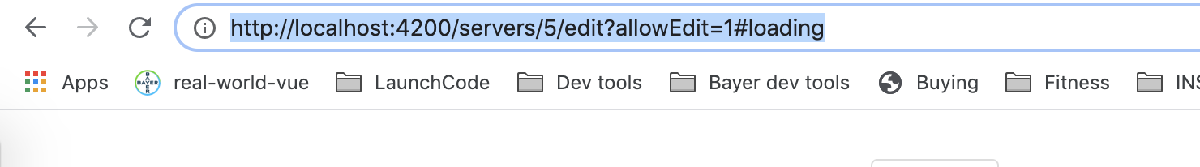
Passing Query parameters and fragments
Notes:
https://basarat.gitbook.io/typescript/future-javascript/classes#access-modifiers
https://medium.com/young-coder/private-fields-in-typescript-3-8-true-privacy-at-last-fb4f194305d9
26

Slide 27
Passing Query parameters and fragments
Notes:
https://basarat.gitbook.io/typescript/future-javascript/classes#access-modifiers
https://medium.com/young-coder/private-fields-in-typescript-3-8-true-privacy-at-last-fb4f194305d9
27

Slide 28
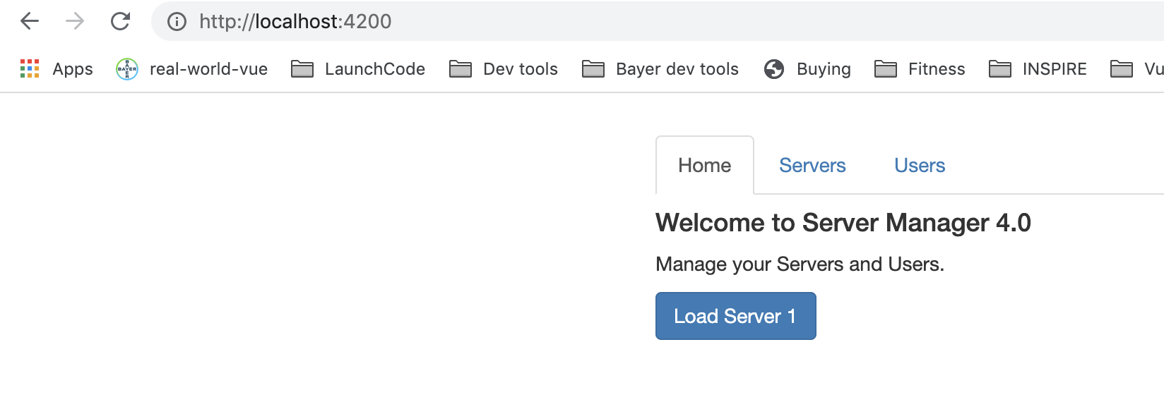
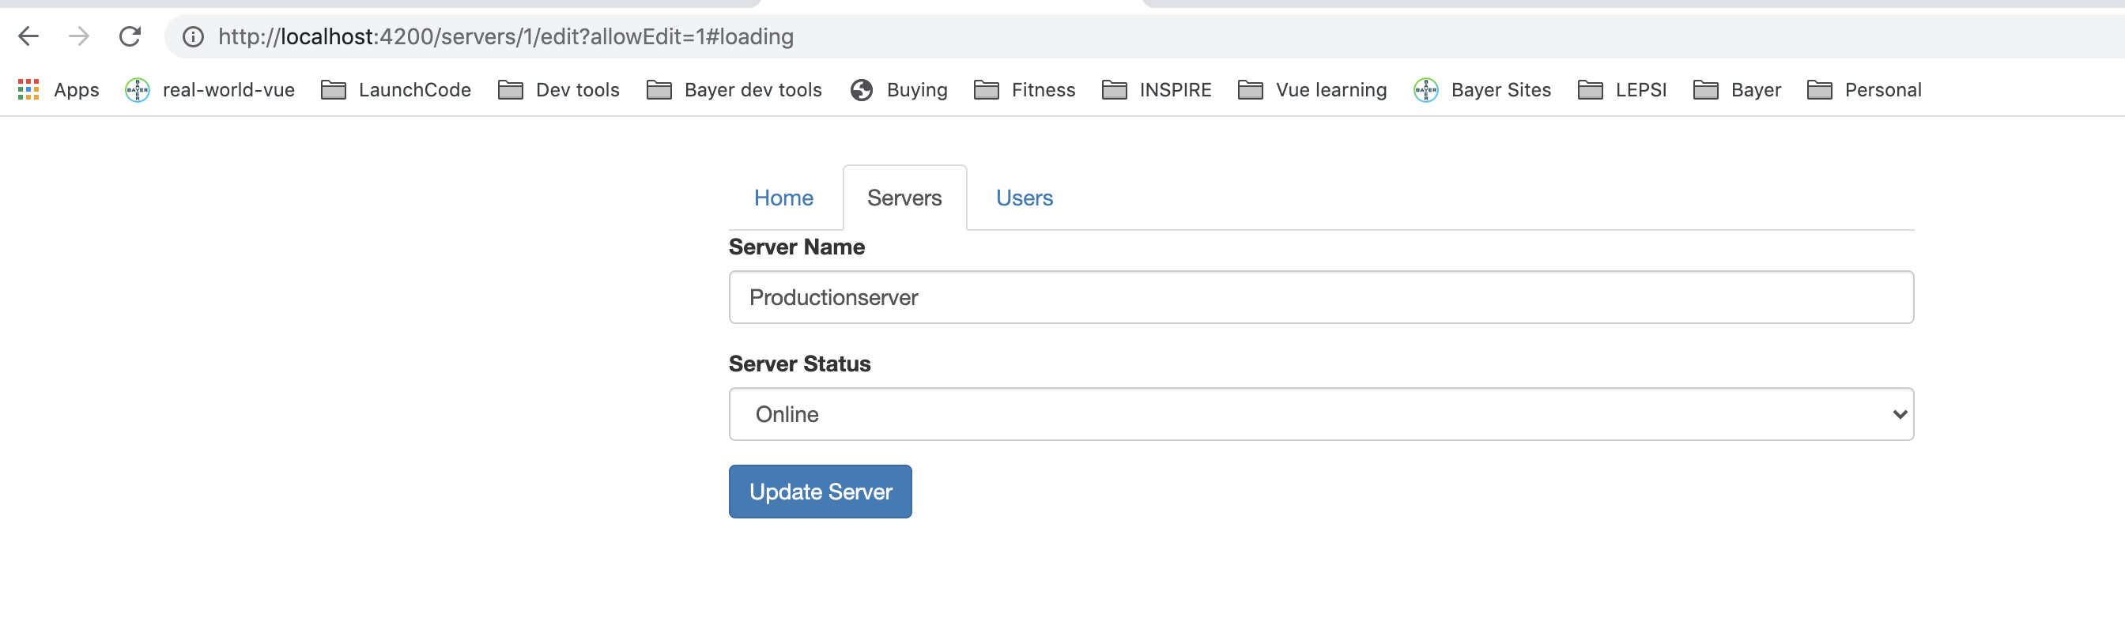
Passing Query parameters and fragments
Notes:
https://basarat.gitbook.io/typescript/future-javascript/classes#access-modifiers
https://medium.com/young-coder/private-fields-in-typescript-3-8-true-privacy-at-last-fb4f194305d9
28

Slide 29
Retrieving Query parameters and fragments
Notes:
https://basarat.gitbook.io/typescript/future-javascript/classes#access-modifiers
https://medium.com/young-coder/private-fields-in-typescript-3-8-true-privacy-at-last-fb4f194305d9
29

Slide 30
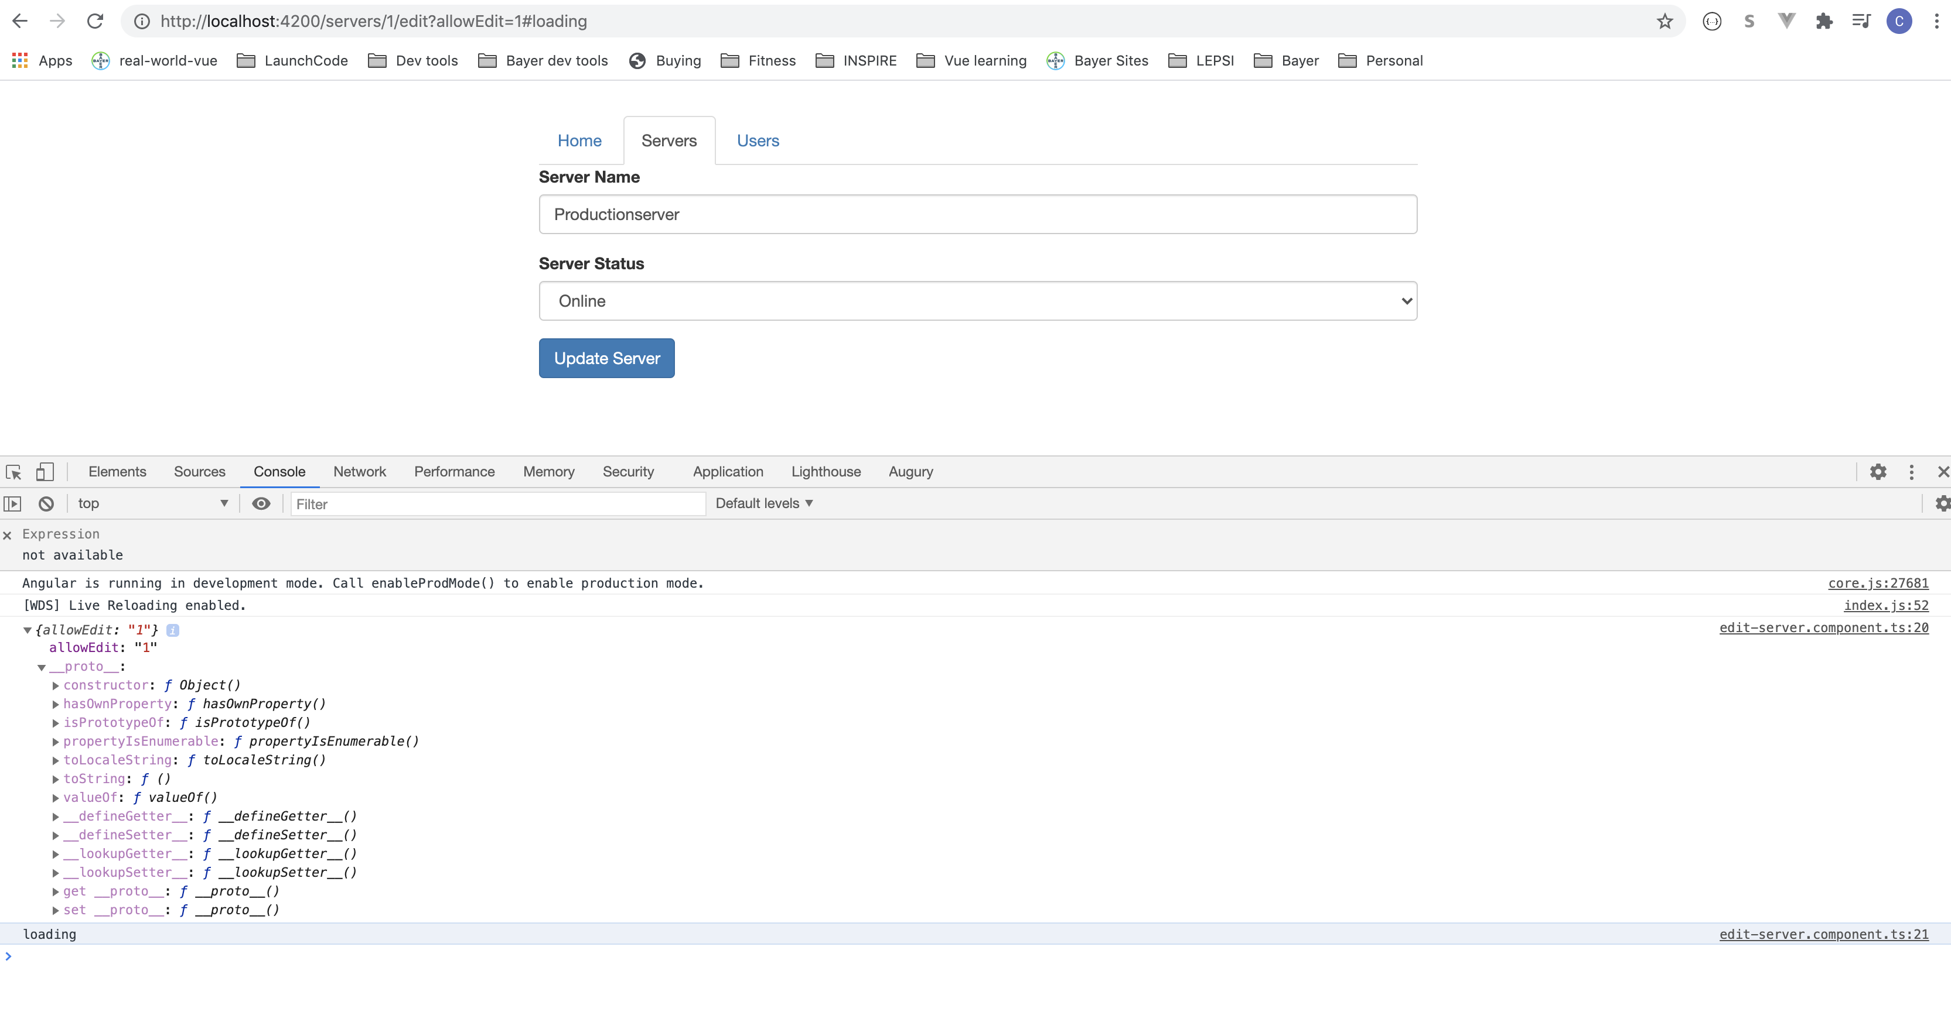
Retrieving Query parameters and fragments
Notes:
https://basarat.gitbook.io/typescript/future-javascript/classes#access-modifiers
https://medium.com/young-coder/private-fields-in-typescript-3-8-true-privacy-at-last-fb4f194305d9
30

Slide 31
Cleaning up
Notes:
https://basarat.gitbook.io/typescript/future-javascript/classes#access-modifiers
https://medium.com/young-coder/private-fields-in-typescript-3-8-true-privacy-at-last-fb4f194305d9
31

Slide 32
Cleaning up
Notes:
https://basarat.gitbook.io/typescript/future-javascript/classes#access-modifiers
https://medium.com/young-coder/private-fields-in-typescript-3-8-true-privacy-at-last-fb4f194305d9
32

Slide 33
Cleaning up
Notes:
https://basarat.gitbook.io/typescript/future-javascript/classes#access-modifiers
https://medium.com/young-coder/private-fields-in-typescript-3-8-true-privacy-at-last-fb4f194305d9
33

Slide 34
Cleaning up
Notes:
https://basarat.gitbook.io/typescript/future-javascript/classes#access-modifiers
https://medium.com/young-coder/private-fields-in-typescript-3-8-true-privacy-at-last-fb4f194305d9
34

Slide 35
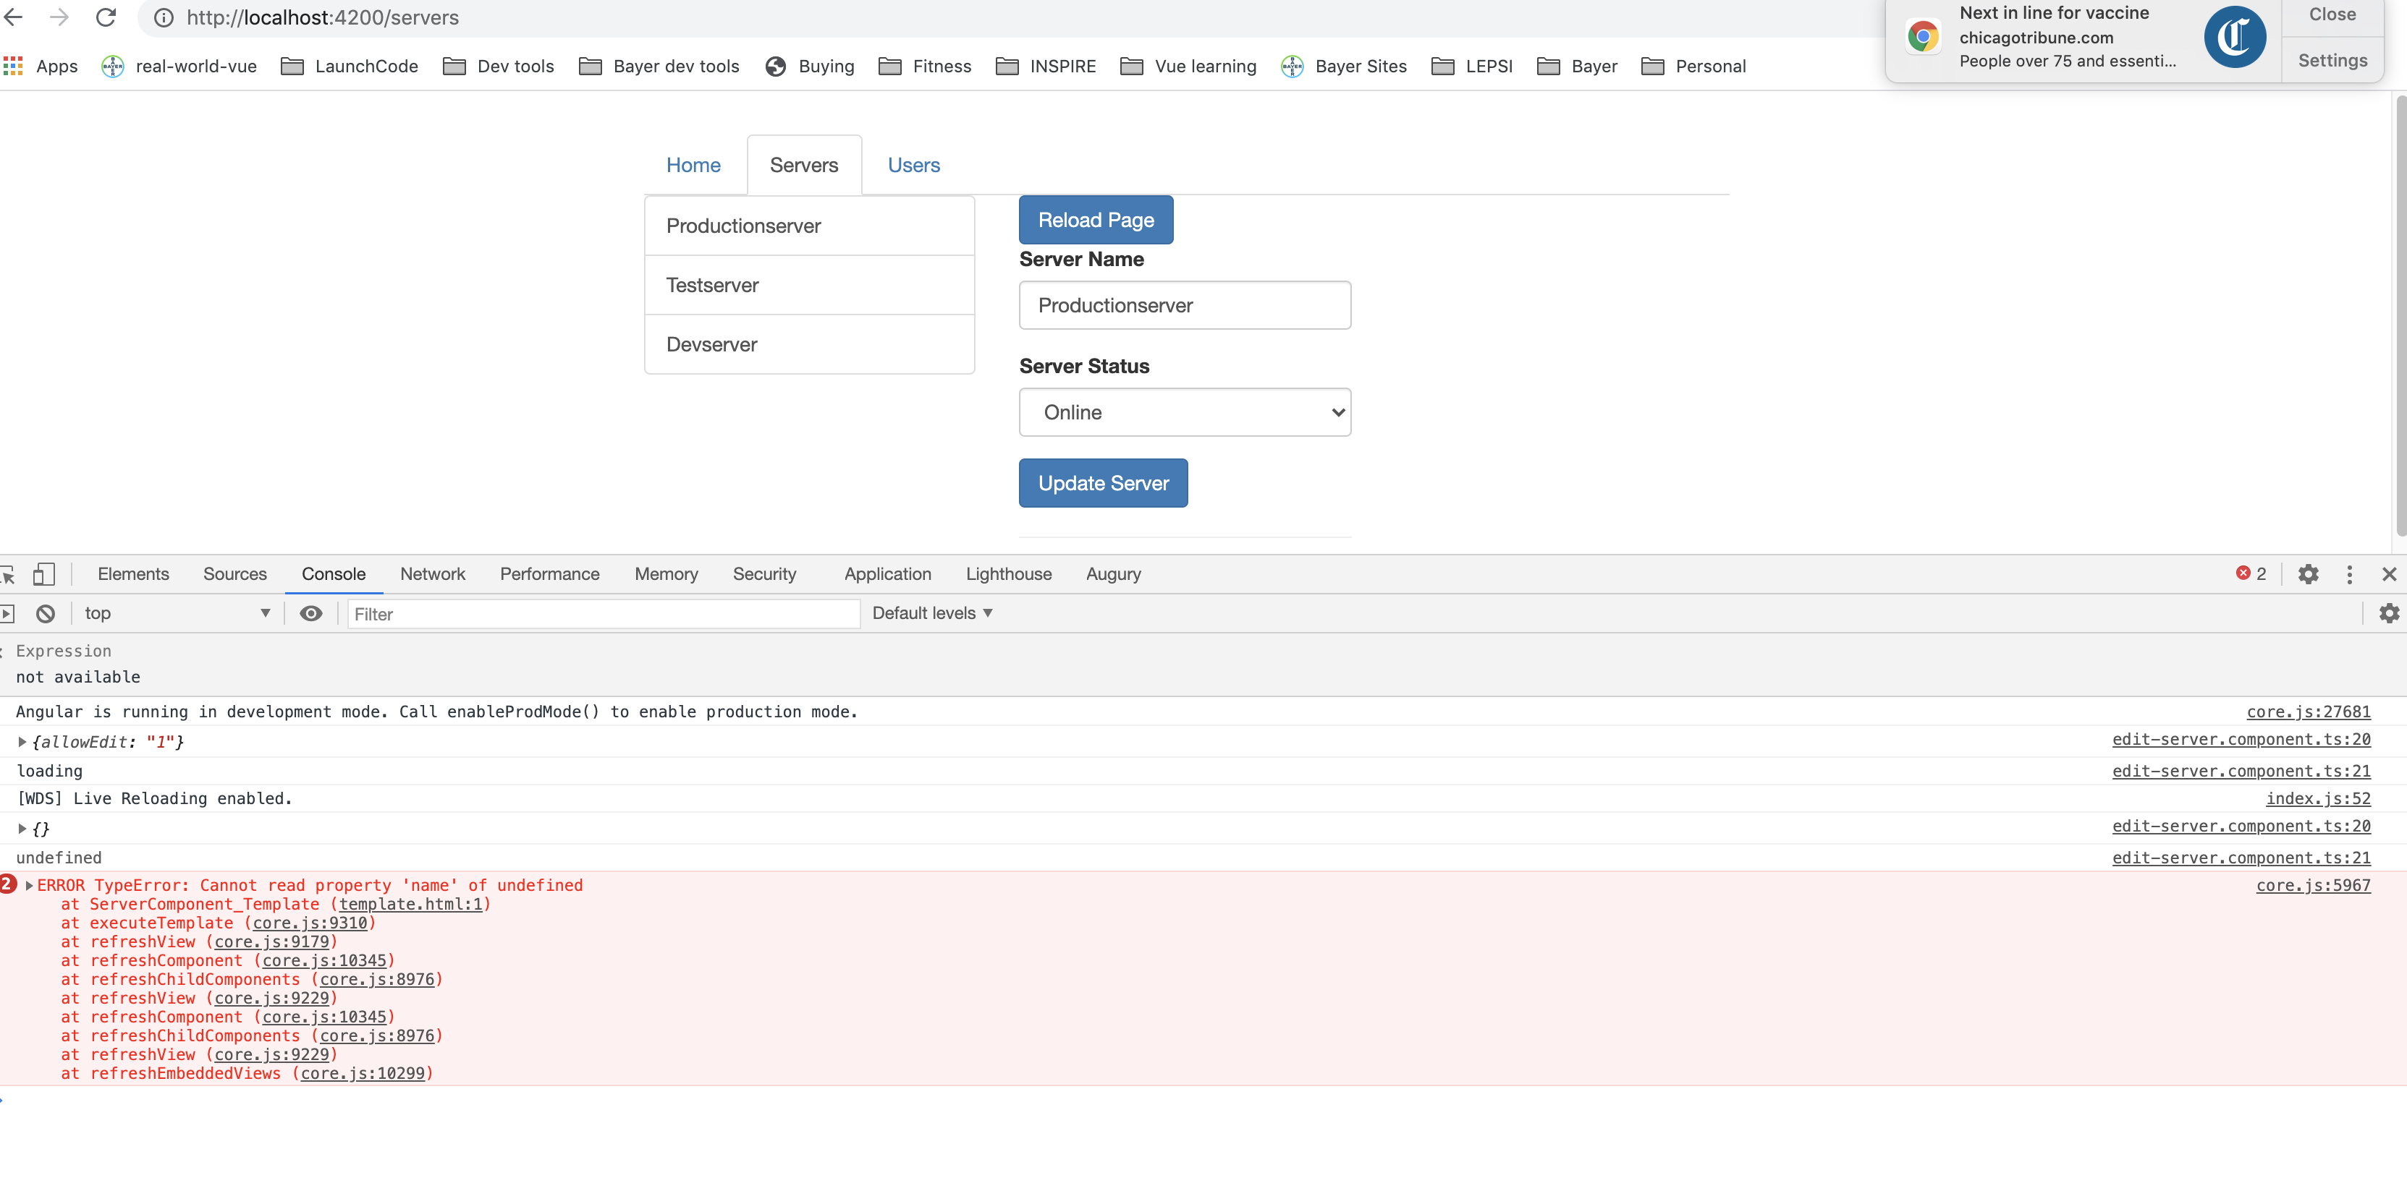
Cleaning up
Notes:
https://basarat.gitbook.io/typescript/future-javascript/classes#access-modifiers
https://medium.com/young-coder/private-fields-in-typescript-3-8-true-privacy-at-last-fb4f194305d9
35

Slide 36
Cleaning up
Notes:
https://basarat.gitbook.io/typescript/future-javascript/classes#access-modifiers
https://medium.com/young-coder/private-fields-in-typescript-3-8-true-privacy-at-last-fb4f194305d9
36

Slide 37
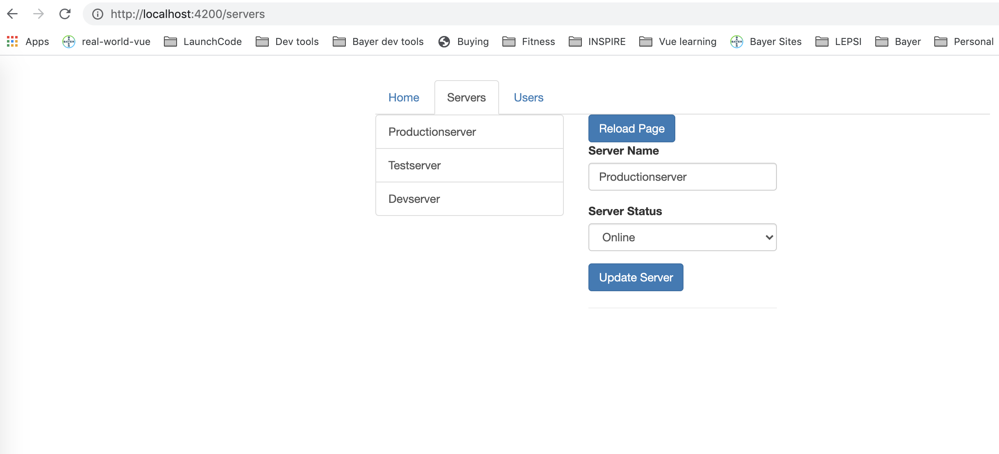
Cleaning up
Notes:
https://basarat.gitbook.io/typescript/future-javascript/classes#access-modifiers
https://medium.com/young-coder/private-fields-in-typescript-3-8-true-privacy-at-last-fb4f194305d9
37

Slide 38
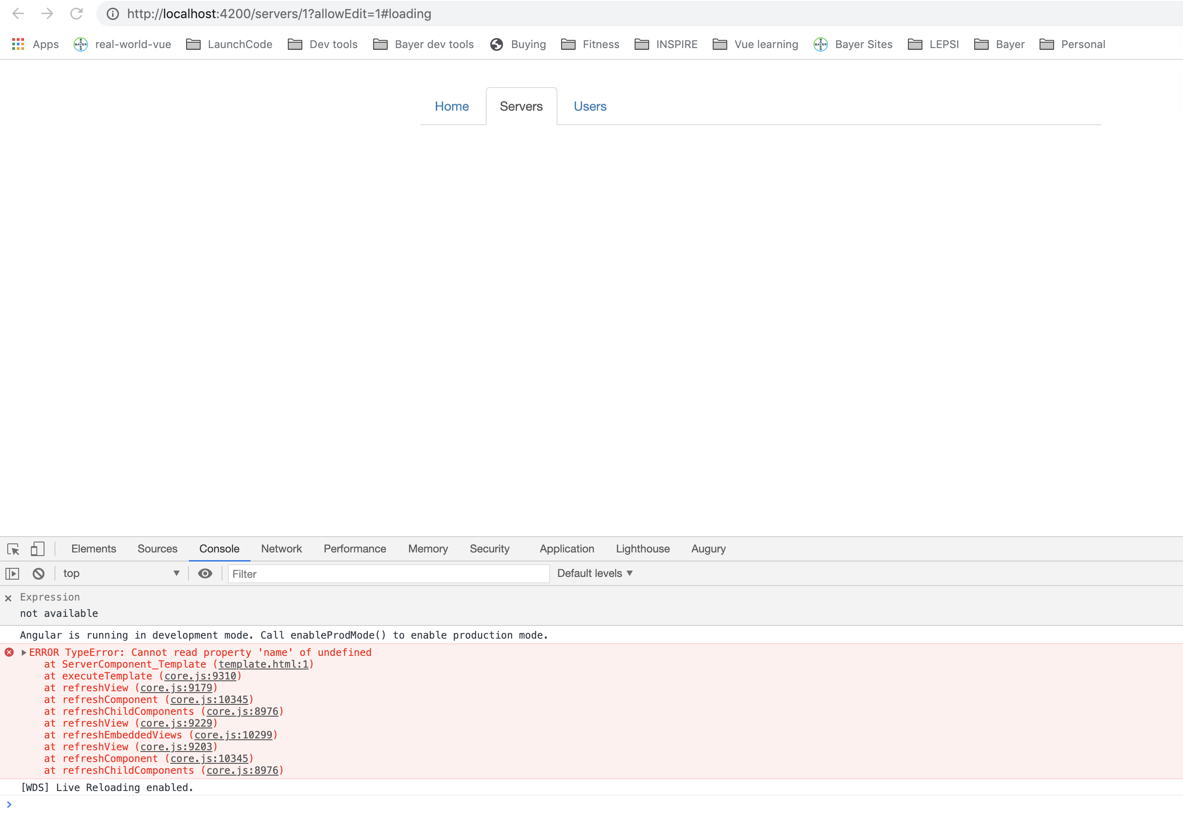
Cleaning up
Notes:
https://basarat.gitbook.io/typescript/future-javascript/classes#access-modifiers
https://medium.com/young-coder/private-fields-in-typescript-3-8-true-privacy-at-last-fb4f194305d9
38

Slide 39
Cleaning up
Notes:
https://basarat.gitbook.io/typescript/future-javascript/classes#access-modifiers
https://medium.com/young-coder/private-fields-in-typescript-3-8-true-privacy-at-last-fb4f194305d9
39

Slide 40
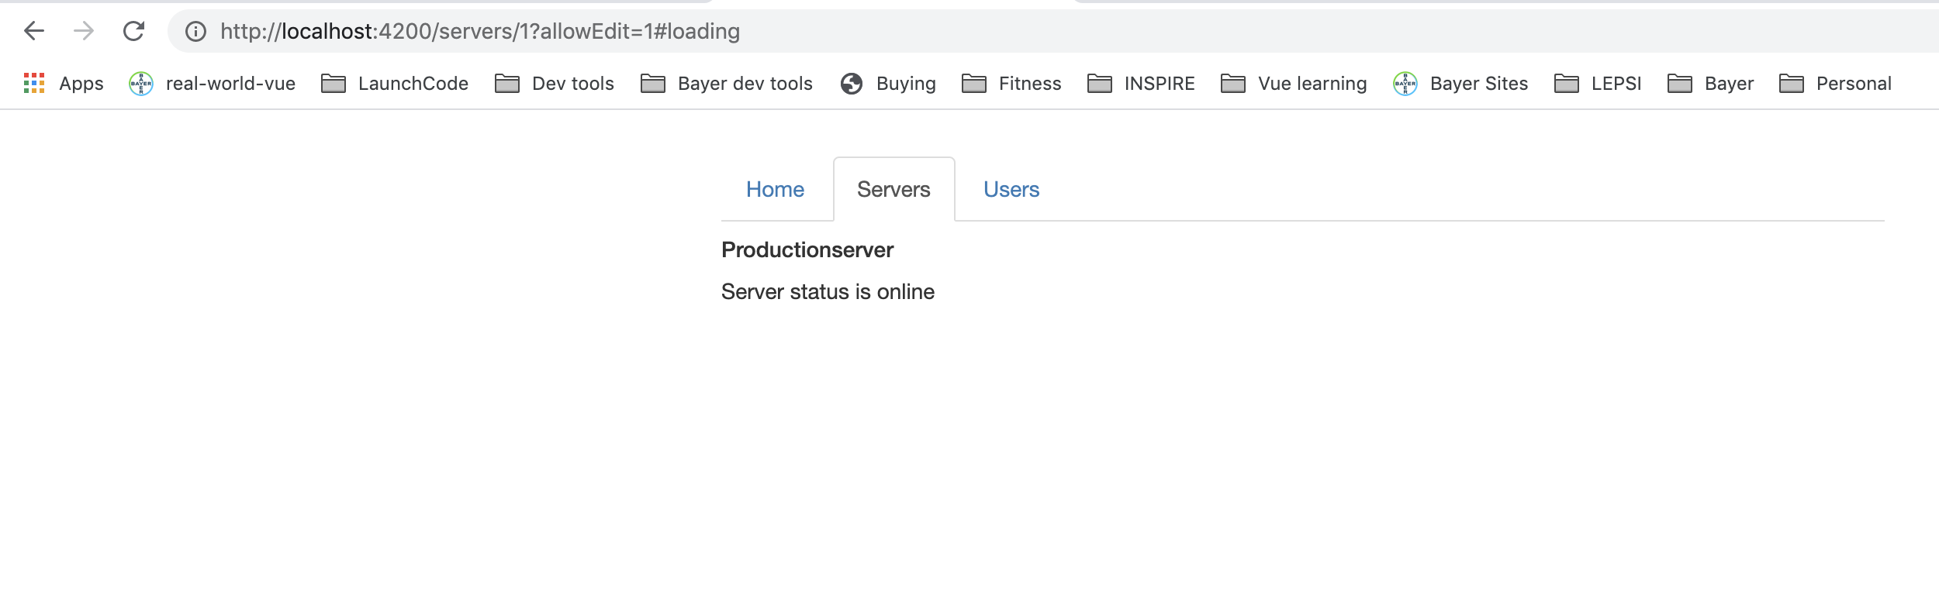
Cleaning up
Notes:
https://basarat.gitbook.io/typescript/future-javascript/classes#access-modifiers
https://medium.com/young-coder/private-fields-in-typescript-3-8-true-privacy-at-last-fb4f194305d9
40

Slide 41
Nested Routes
Can add child routes to nest
Notes:
https://basarat.gitbook.io/typescript/future-javascript/classes#access-modifiers
https://medium.com/young-coder/private-fields-in-typescript-3-8-true-privacy-at-last-fb4f194305d9
41

Slide 42
Nested Routes
Servers.component.html
Notes:
https://basarat.gitbook.io/typescript/future-javascript/classes#access-modifiers
https://medium.com/young-coder/private-fields-in-typescript-3-8-true-privacy-at-last-fb4f194305d9
42

Slide 43
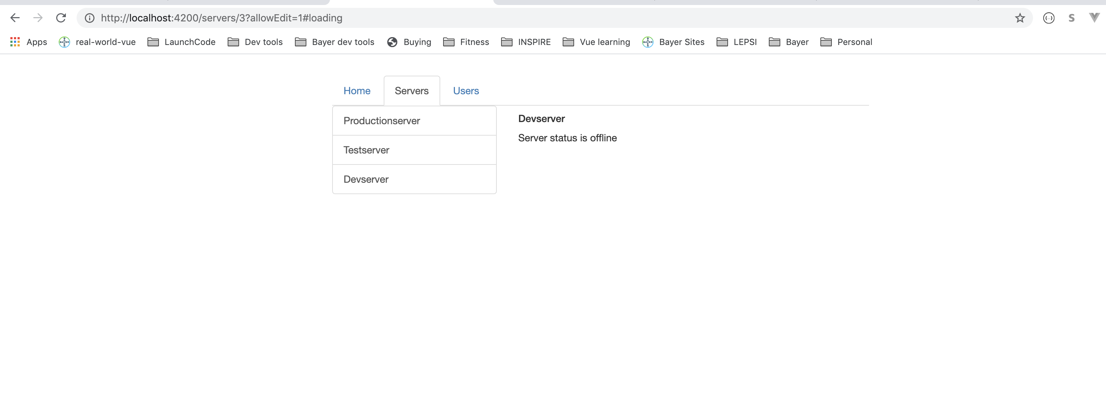
Nested Routes
Notes:
https://basarat.gitbook.io/typescript/future-javascript/classes#access-modifiers
https://medium.com/young-coder/private-fields-in-typescript-3-8-true-privacy-at-last-fb4f194305d9
43

Slide 44
Nested Routes
user.component.html
Notes:
https://basarat.gitbook.io/typescript/future-javascript/classes#access-modifiers
https://medium.com/young-coder/private-fields-in-typescript-3-8-true-privacy-at-last-fb4f194305d9
44

Slide 45
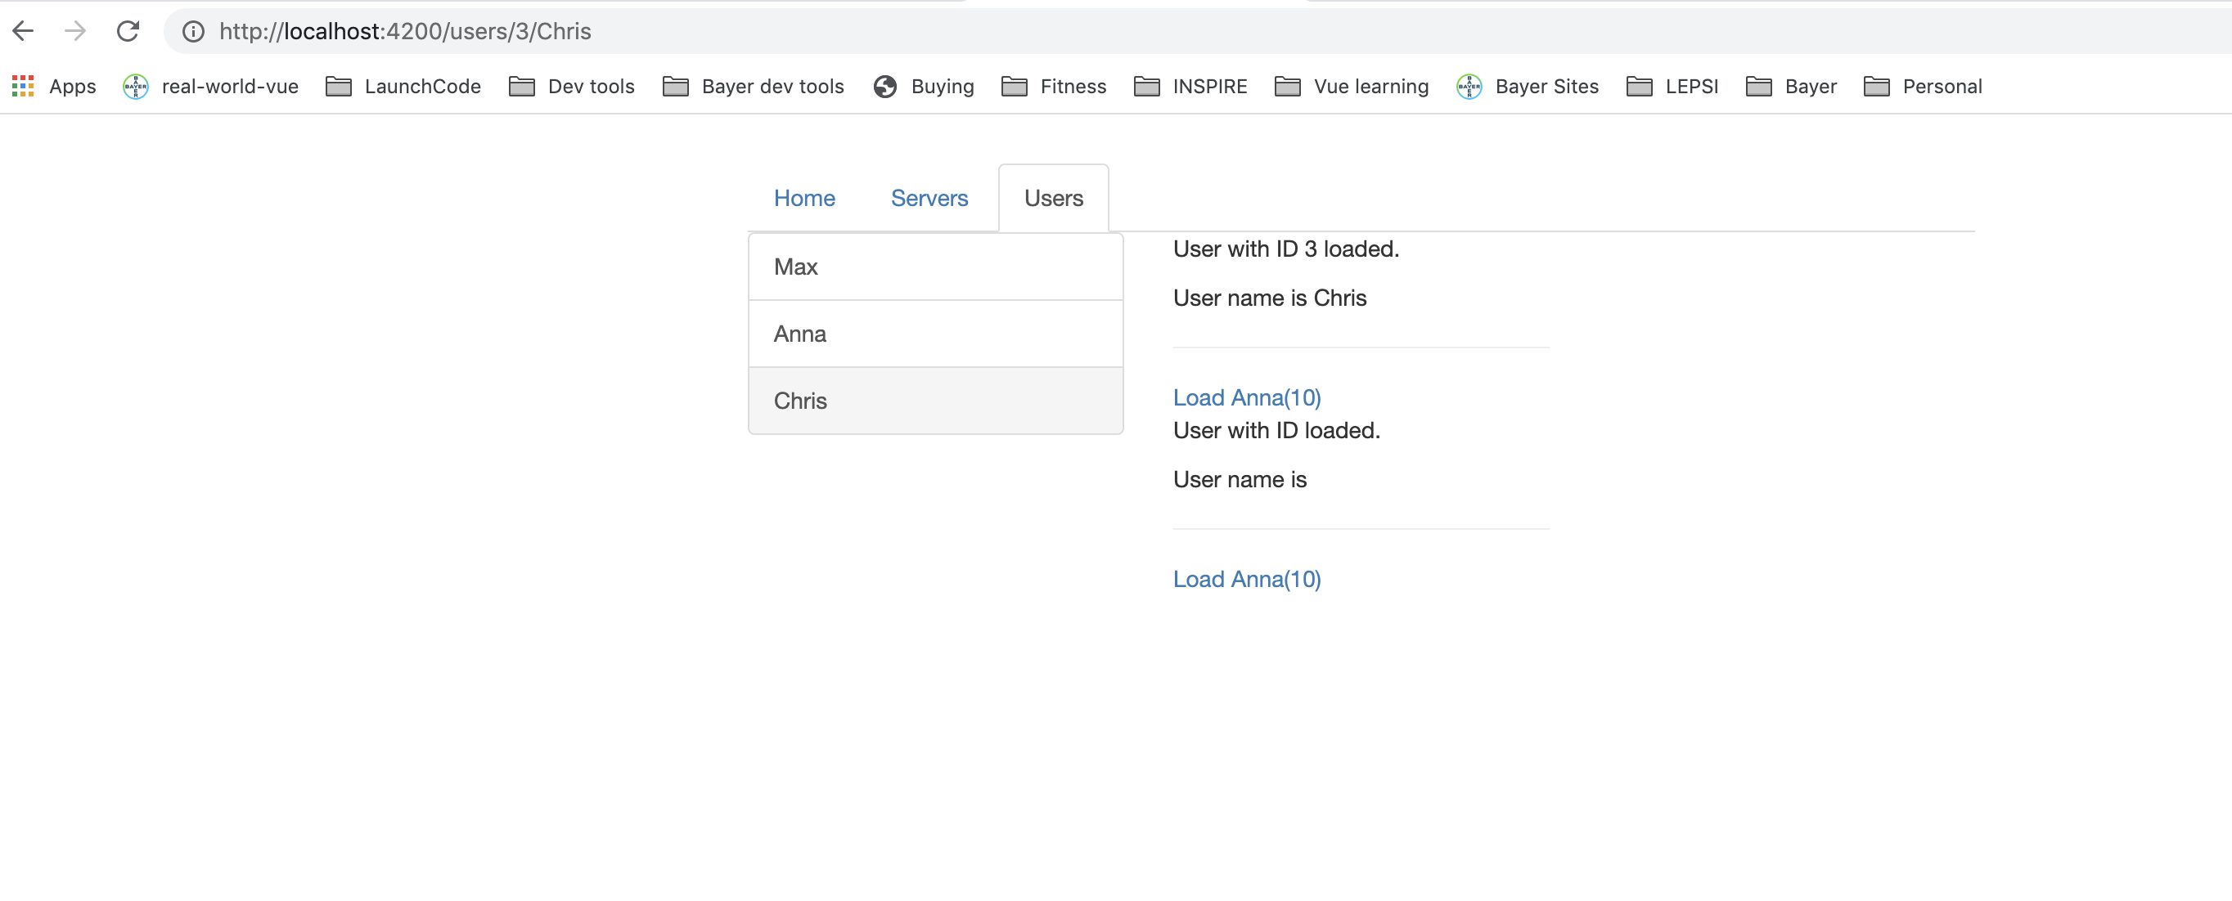
Nested Routes
Notes:
https://basarat.gitbook.io/typescript/future-javascript/classes#access-modifiers
https://medium.com/young-coder/private-fields-in-typescript-3-8-true-privacy-at-last-fb4f194305d9
45

Slide 46
Using Query Parameters
server.component.html
server.component.ts
Notes:
https://basarat.gitbook.io/typescript/future-javascript/classes#access-modifiers
https://medium.com/young-coder/private-fields-in-typescript-3-8-true-privacy-at-last-fb4f194305d9
46

Slide 47
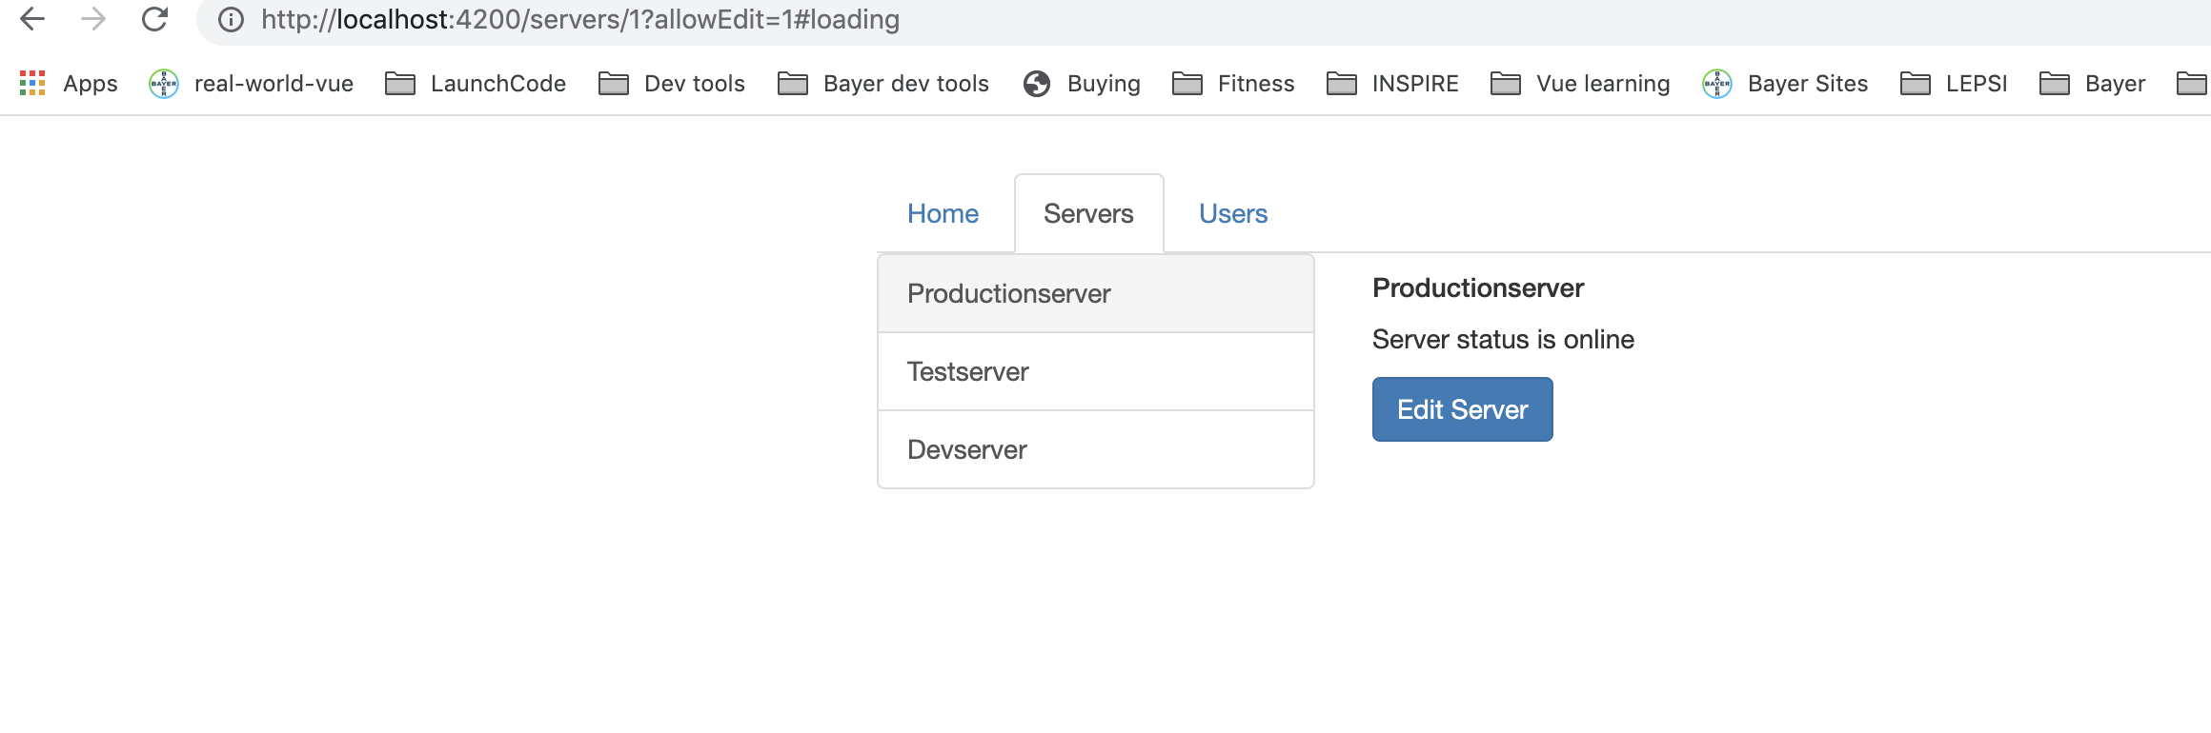
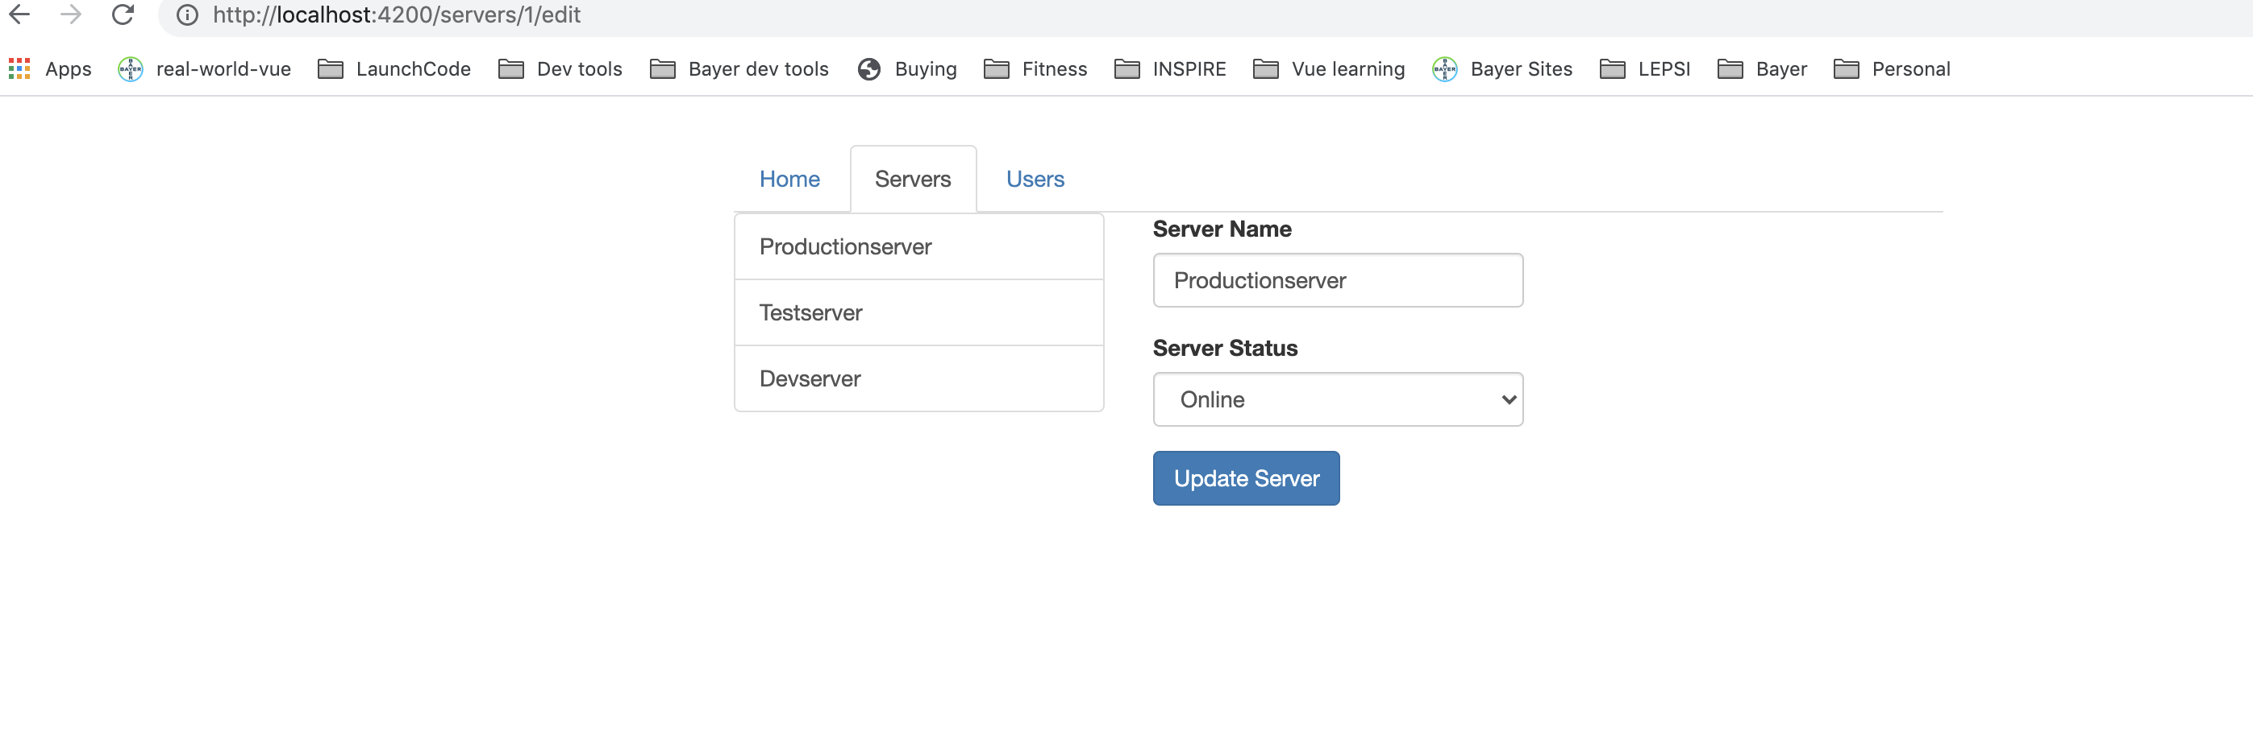
Using Query Parameters
server.component.html
Notes:
https://basarat.gitbook.io/typescript/future-javascript/classes#access-modifiers
https://medium.com/young-coder/private-fields-in-typescript-3-8-true-privacy-at-last-fb4f194305d9
47

Slide 48
Using Query Parameters
servers.component.html
Notes:
https://basarat.gitbook.io/typescript/future-javascript/classes#access-modifiers
https://medium.com/young-coder/private-fields-in-typescript-3-8-true-privacy-at-last-fb4f194305d9
48

Slide 49
Using Query Parameters
edit-server.component.ts
Notes:
https://basarat.gitbook.io/typescript/future-javascript/classes#access-modifiers
https://medium.com/young-coder/private-fields-in-typescript-3-8-true-privacy-at-last-fb4f194305d9
49

Slide 50
Using Query Parameters
edit-server.component.html
Notes:
https://basarat.gitbook.io/typescript/future-javascript/classes#access-modifiers
https://medium.com/young-coder/private-fields-in-typescript-3-8-true-privacy-at-last-fb4f194305d9
50

Slide 51
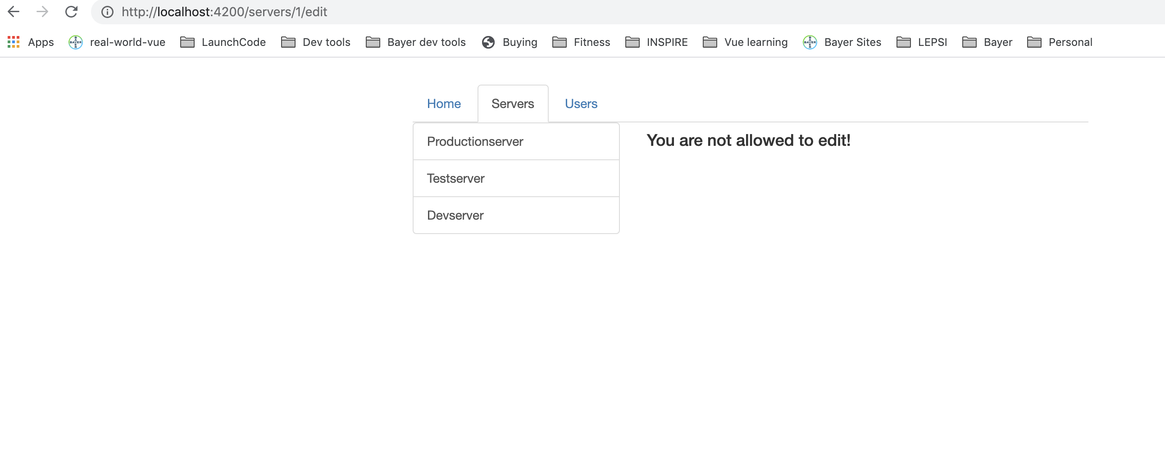
Using Query Parameters
Notes:
https://basarat.gitbook.io/typescript/future-javascript/classes#access-modifiers
https://medium.com/young-coder/private-fields-in-typescript-3-8-true-privacy-at-last-fb4f194305d9
51

Slide 52
Using Query Parameters
Notes:
https://basarat.gitbook.io/typescript/future-javascript/classes#access-modifiers
https://medium.com/young-coder/private-fields-in-typescript-3-8-true-privacy-at-last-fb4f194305d9
52

Slide 53
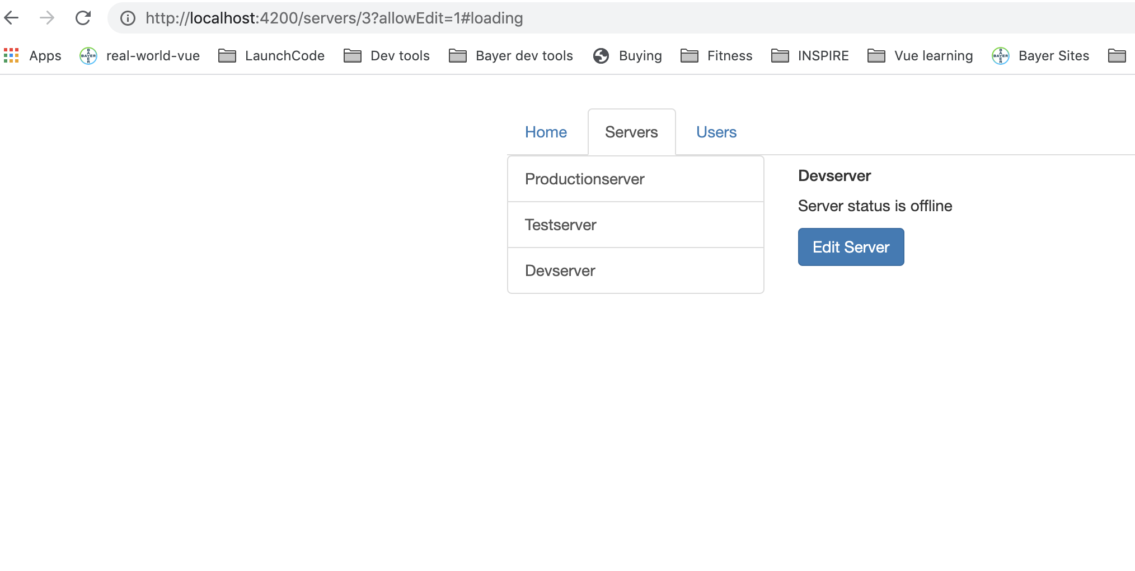
Using Query Parameters
Notes:
https://basarat.gitbook.io/typescript/future-javascript/classes#access-modifiers
https://medium.com/young-coder/private-fields-in-typescript-3-8-true-privacy-at-last-fb4f194305d9
53

Slide 54
Redirecting and Wildcard Routes
ng g c page-not-found
page-not-found.component.html
Notes:
https://basarat.gitbook.io/typescript/future-javascript/classes#access-modifiers
https://medium.com/young-coder/private-fields-in-typescript-3-8-true-privacy-at-last-fb4f194305d9
54

Slide 55

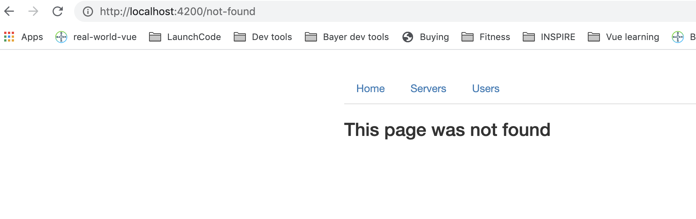
Redirecting and Wildcard Routes
Notes:
https://basarat.gitbook.io/typescript/future-javascript/classes#access-modifiers
https://medium.com/young-coder/private-fields-in-typescript-3-8-true-privacy-at-last-fb4f194305d9
55

Slide 56
Redirecting and Wildcard Routes
Catch all paths you don’t know. The generic route should be at the bottom otherwise all paths take you there!
Notes:
https://basarat.gitbook.io/typescript/future-javascript/classes#access-modifiers
https://medium.com/young-coder/private-fields-in-typescript-3-8-true-privacy-at-last-fb4f194305d9
56

Slide 57
Outsourcing the Route Configuration
app-routing.module.ts
Notes:
https://basarat.gitbook.io/typescript/future-javascript/classes#access-modifiers
https://medium.com/young-coder/private-fields-in-typescript-3-8-true-privacy-at-last-fb4f194305d9
57

Slide 58
Outsourcing the Route Configuration
app.module.ts
Notes:
https://basarat.gitbook.io/typescript/future-javascript/classes#access-modifiers
https://medium.com/young-coder/private-fields-in-typescript-3-8-true-privacy-at-last-fb4f194305d9
58

Slide 59
Guards
Route Guards – functionality before/after entering a route
canActivate guard - auth-guard.service.ts
Notes:
https://basarat.gitbook.io/typescript/future-javascript/classes#access-modifiers
https://medium.com/young-coder/private-fields-in-typescript-3-8-true-privacy-at-last-fb4f194305d9
59

Slide 60
Guards
auth.service.ts
Notes:
https://basarat.gitbook.io/typescript/future-javascript/classes#access-modifiers
https://medium.com/young-coder/private-fields-in-typescript-3-8-true-privacy-at-last-fb4f194305d9
60

Slide 61
Guards
app.module.ts
Notes:
https://basarat.gitbook.io/typescript/future-javascript/classes#access-modifiers
https://medium.com/young-coder/private-fields-in-typescript-3-8-true-privacy-at-last-fb4f194305d9
61

Slide 62
Guards
app.routing.module.ts
Notes:
https://basarat.gitbook.io/typescript/future-javascript/classes#access-modifiers
https://medium.com/young-coder/private-fields-in-typescript-3-8-true-privacy-at-last-fb4f194305d9
62

Slide 63
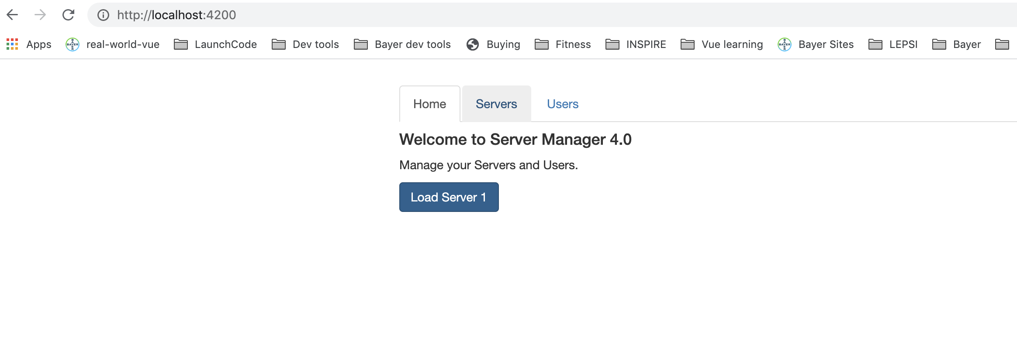
Guards
Servers does not take you anywhere at first and after 800 sec it takes you.
Notes:
https://basarat.gitbook.io/typescript/future-javascript/classes#access-modifiers
https://medium.com/young-coder/private-fields-in-typescript-3-8-true-privacy-at-last-fb4f194305d9
63

Slide 64
Protecting Child Routes
Can specify canActivate to each child
There is also canActivateChild interface/
app.routing.module.ts
Notes:
https://basarat.gitbook.io/typescript/future-javascript/classes#access-modifiers
https://medium.com/young-coder/private-fields-in-typescript-3-8-true-privacy-at-last-fb4f194305d9
64

Slide 65
Protecting Child Routes
auth-guard.service.ts
Notes:
https://basarat.gitbook.io/typescript/future-javascript/classes#access-modifiers
https://medium.com/young-coder/private-fields-in-typescript-3-8-true-privacy-at-last-fb4f194305d9
65

Slide 66
Using Fake Auth Service
Notes:
https://basarat.gitbook.io/typescript/future-javascript/classes#access-modifiers
https://medium.com/young-coder/private-fields-in-typescript-3-8-true-privacy-at-last-fb4f194305d9
66

Slide 67
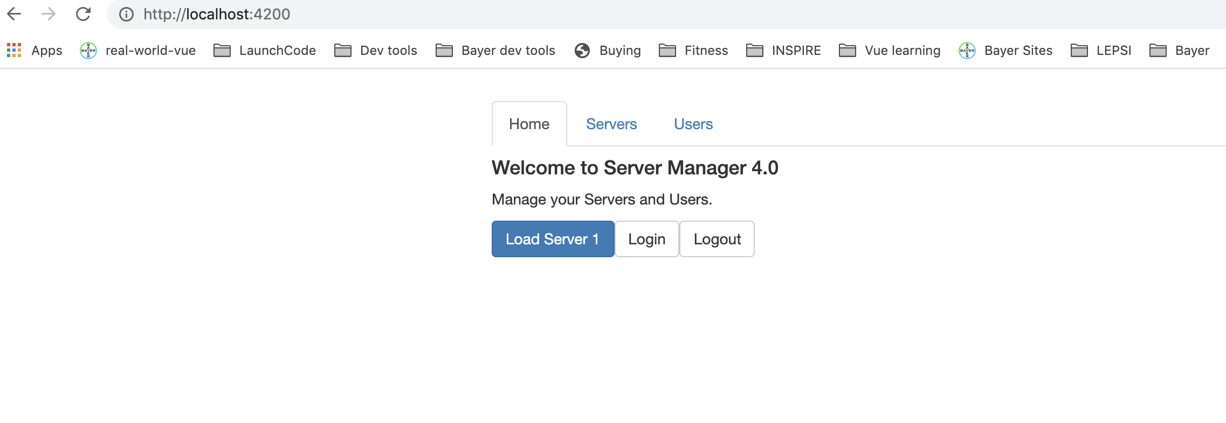
Using Fake Auth Service
If you logout then it takes you to Home tab and login works
Notes:
https://basarat.gitbook.io/typescript/future-javascript/classes#access-modifiers
https://medium.com/young-coder/private-fields-in-typescript-3-8-true-privacy-at-last-fb4f194305d9
67

Slide 68
canDeactivate
Convenience method to prevent user from accidentally navigating away.
Notes:
https://basarat.gitbook.io/typescript/future-javascript/classes#access-modifiers
https://medium.com/young-coder/private-fields-in-typescript-3-8-true-privacy-at-last-fb4f194305d9
68

Slide 69
Summary
Notes:
https://basarat.gitbook.io/typescript/future-javascript/classes#access-modifiers
https://medium.com/young-coder/private-fields-in-typescript-3-8-true-privacy-at-last-fb4f194305d9
69

Slide 70
Questions?

Slide 71
Studio
Assignment 5: Practicing Services
Section 10: Course Project - Services & Dependency Injection

